Slide 1





Presenter :
BRIJESH PATEL
Exploratory Data Analysis :
Real Estate Pricing
NEXT HIKE Solutions

Slide 2



Project Overview
What I Have Created :-
Performed EDA on housing data
Handled missing values and anomalies
Created custom features and visualizations
Key Functions Added :-
PricePerSqFt, HouseAge, Remodeled, HasGarage, HasPool
Uniqueness :-
Real-estate-based engineered features, advanced visualizations
WHY THESE FUNCTIONS.?
To improve model performance and data understanding

Slide 3



Libraries and its functionality
Libraries Used :-
Pandas :- For importing, Data Cleaning, Data modification and Data analysis
Seaborn :- Ploting a Graph for data visualization
MatPlotlib :- By adding multiple functionality we can make Graph attractive
GUI Features :-
KDE Plots, Heatmaps, Boxplots, Pair-plots
Interactive data visual exploration

Slide 4


Challenges & Solutions
Challenges :-
Missing values (LotFrontage, GarageYrBlt)
Outliers, duplicate entries, skewed features
Which Features to consider for Feature Engineering
Choose data for Data Visualization
How I Overcame Them :-
Imputation, de-duplication, feature engineering
Visualization to identify and mitigate anomalies
Done online research of different projects
Try to include all the important features for Data Visualization

Slide 5


Sales Price is right-skewed (~1.88)
Strong correlation with Rates the overall material and finish of the house and Above grade (ground) living area square feet
Garage & Central Air increase Sales Price of a House
Pools are rare but add premium value as Customer want this amenity at higher cost
Remodeled and newer houses fetch better prices as compare to older houses
Data Insights

Slide 6

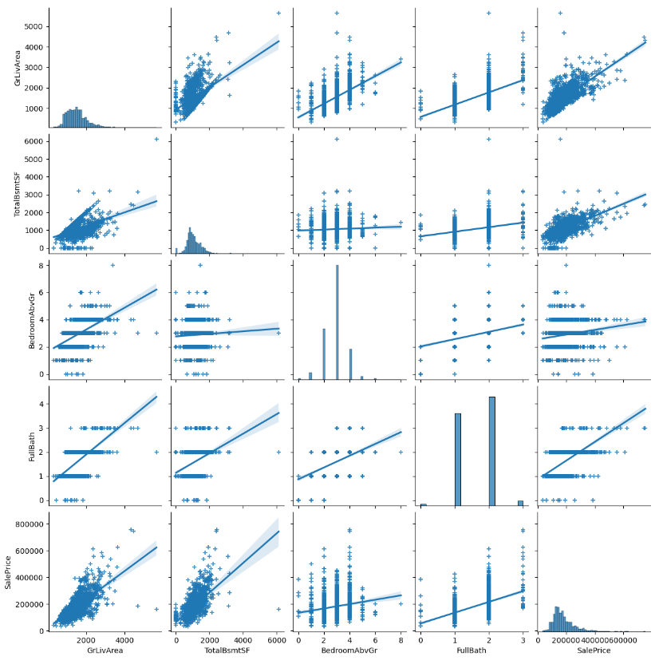
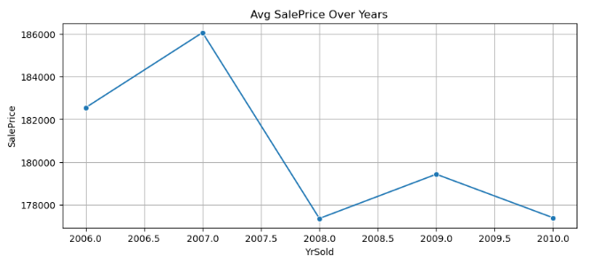
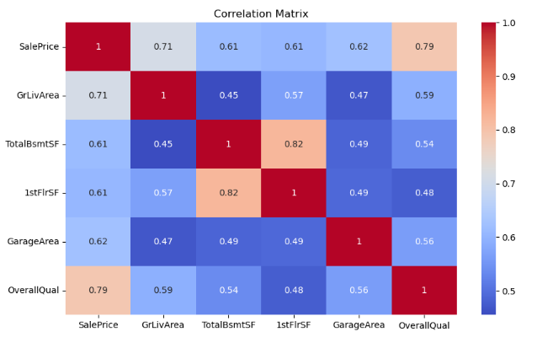
Data Visualization

Slide 7

Thank You..!!

